Slide 1
Chapter 7
Memory and Programmable Logic

Slide 2
1) Introduction
There are two types of memories that are used in digital systems:
Random-access memory(RAM): perform both the write and read operations.
Read-only memory(ROM): perform only the read operation.
The read-only memory is a programmable logic device. Other such units are the programmable logic array(PLA), the programmable array logic(PAL), and the field-programmable gate array(FPGA).

Slide 3
Programmable Logic Device
A programmable logic device (PLD) is an electronic component used to build reconfigurable digital circuits.
Unlike integrated circuits (IC) which consist of logic gates and have a fixed function, a PLD has an undefined function at the time of manufacture.
Before the PLD can be used in a circuit it must be programmed (reconfigured) by using a specialized program
The process of entering the information into these devices is known as programming. Basically, users can program these devices or ICs electrically in order to implement the Boolean functions based on the requirement.
Here, the term programming refers to hardware programming, not software programming.

Slide 4
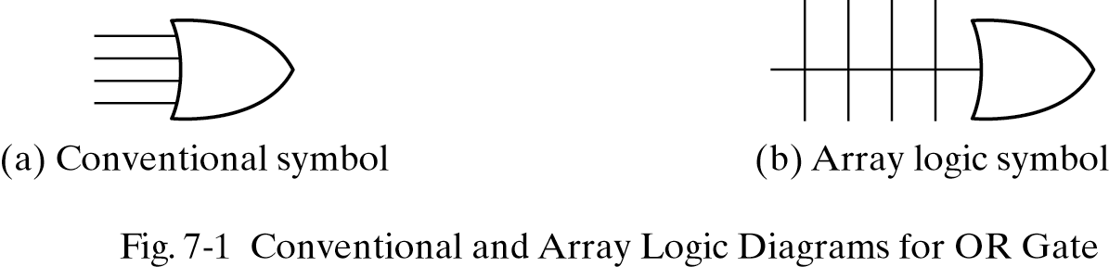
Array logic
A typical programmable logic device may have hundreds to millions of gates interconnected through hundreds to thousands of internal paths.
In order to show the internal logic diagram in a concise form, it is necessary to employ a special gate symbology applicable to array logic.

Slide 5
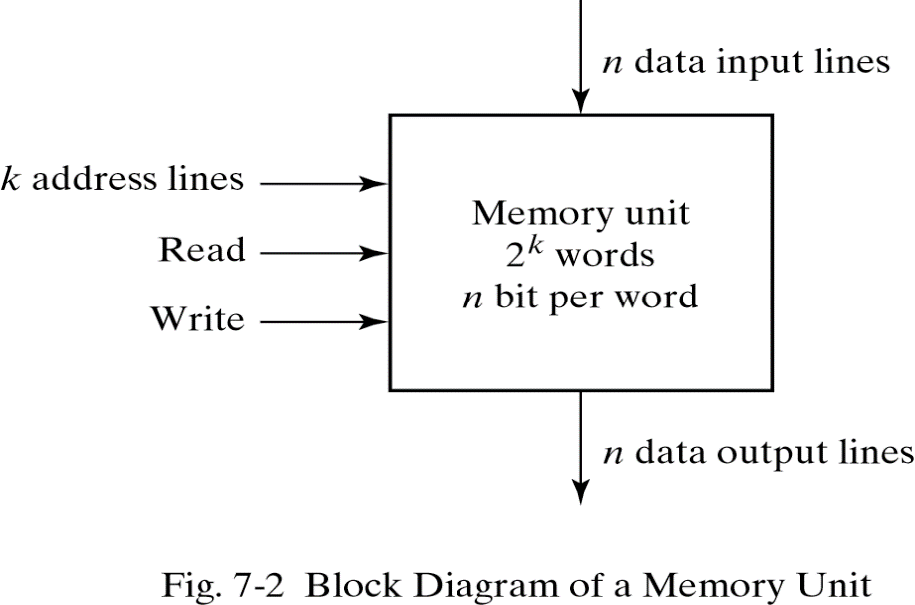
2) Random-Access Memory
A memory unit stores binary information in groups of bits called words.
1 byte = 8 bits
1 word = 2 bytes
The communication between a memory and its environment is achieved through data input and output lines, address selection lines, and control lines that specify the direction of transfer.

Slide 6
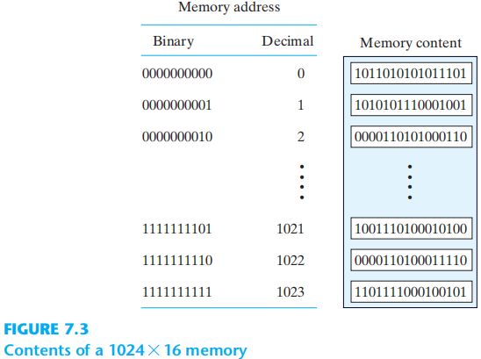
Contents of Memory

Slide 7
Content of a memory
Figure 7.3 in previous slide shows possible contents of the first three and the last three words of this memory. Each word contains 16 bits that can be divided into two bytes. The words are recognized by their decimal address from 0 to 1,023. The equivalent binary address consists of 10 bits.
The first address is specified with ten 0’s; the last address is specified with ten 1’s, because 1,023 in binary is equal to 1111111111. A word in memory is selected by its binary address. When a word is read or written, the memory operates on all 16 bits as a single unit.
The 1K * 16 memory of Fig. 7.3 has 10 bits in the address and 16 bits in each word. As another example, a 64K * 10 memory will have 16 bits in the address (since 64K = 2¹⁶ ) and each word will consist of 10 bits

Slide 8
Content of a memory
Each word in memory is assigned an identification number, called an address, starting from 0 up to 2^{k}-1, where k is the number of address lines.
The selection of a specific word inside memory is done by applying the k ‐bit address to the address lines.
An internal decoder accepts this address and opens the paths needed to select the word specified.
Memories vary greatly in size and may range from 1,024 (2¹⁰) words, requiring an address of 10 bits, to 2³² words, requiring 32 address bits
It is customary to refer to the number of words (or bytes) in memory with one of the letters K (kilo), M (mega), and G (giga). K is equal to 2^{10, M is equal to} 2^{20, and G is equal to} 230. Thus, 1 Kilobyte = 2^10 (1024) Bytes

Slide 9
Write and Read operations
Transferring a new word to be stored into memory:
Apply the binary address of the desired word to the address lines.
Apply the data bits that must be stored in memory to the data input lines.
Activate the write input.

Slide 10
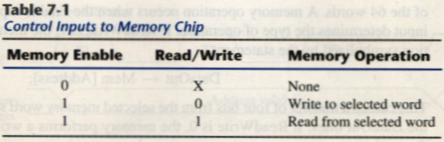
Write and Read operations
Transferring a stored word out of memory:
Apply the binary address of the desired word to the address lines.
Activate the read input.
Commercial memory sometimes provide the two control inputs for reading and writing in a somewhat different configuration in table 7-1.

Slide 11
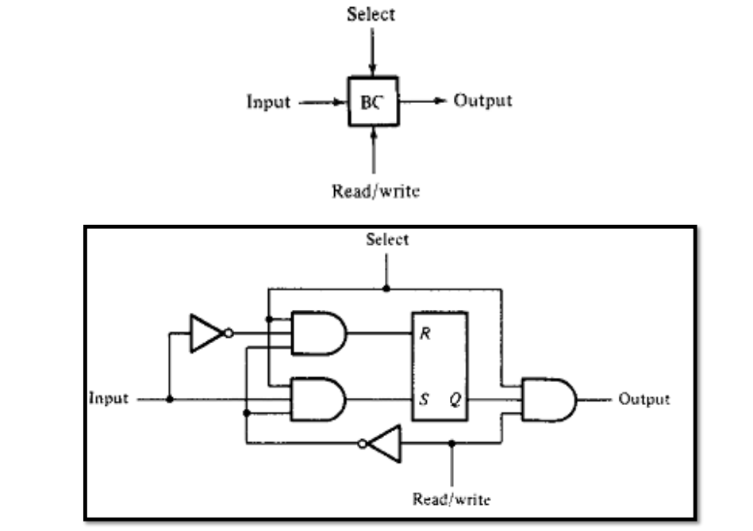
Single Cell
The binary storage cell is the basic building block of a memory unit. The equivalent logic of
a binary cell that stores one bit of information is shown here

Slide 12
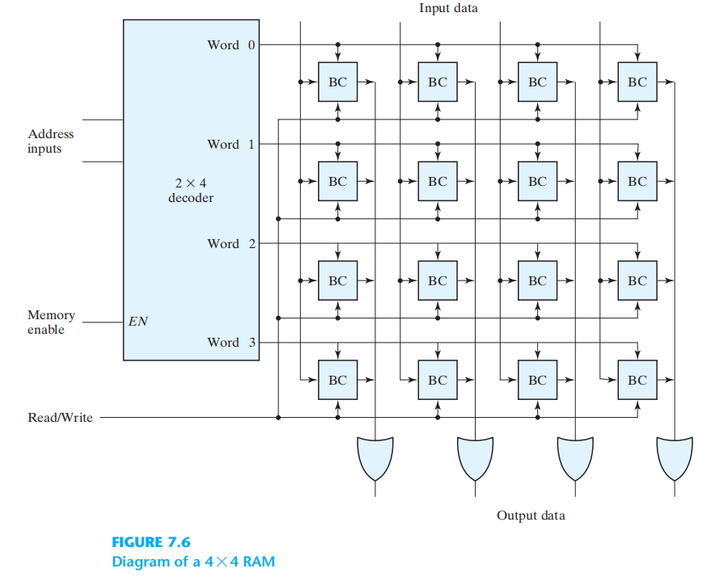
Memory (RAM)
The internal construction of a RAM of m words and n bits per word consists of m * n
binary storage cells and associated decoding circuits for selecting individual words

Slide 13
Types of memories
In random-access memory, the word locations may be thought of as being separated in space, with each word occupying one particular location.
In sequential-access memory, the information stored in some medium is not immediately accessible, but is available only certain intervals of time. A magnetic disk or tape unit is of this type.

Slide 14
Types of memories
In a random-access memory, the access time is always the same regardless of the particular location of the word.
In a sequential-access memory, the time it takes to access a word depends on the position of the word with respect to the reading head position; therefore, the access time is variable.

Slide 15
Static RAM
SRAM consists essentially of internal latches that store the binary information.
The stored information remains valid as long as power is applied to the unit.
SRAM is easier to use and has shorter read and write cycles.
Low density, low capacity, high cost, high speed, high power consumption.

Slide 16
Dynamic RAM
DRAM stores the binary information in the form of electric charges on capacitors.
The capacitors are provided inside the chip by MOS (metal–oxide–silicon) transistors.
The capacitors tends to discharge with time and must be periodically recharged by refreshing the dynamic memory.

Slide 17
Dynamic RAM
DRAM offers reduced power consumption and larger storage capacity in a single memory chip.
High density, high capacity, low cost, low speed, low power consumption.

Slide 18
Volatile and Nonvolatile memory
Memory units that lose stored information when power is turned off are said to be volatile like the RAM
Both static and dynamic, are of this category since the binary cells need external power to maintain the stored information.
Nonvolatile memory, such as magnetic disk, ROM, retains its stored information after removal of power.

Slide 19
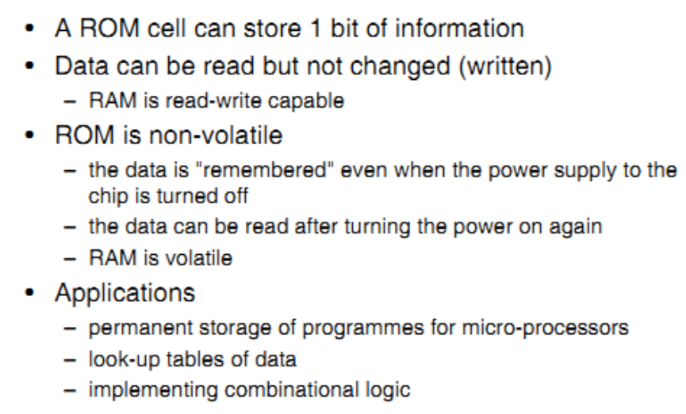
3) Read-Only Memory (ROM)

Slide 20
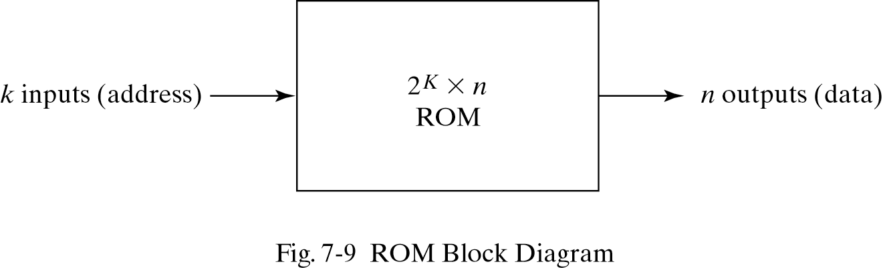
ROM Block Diagram
A block diagram of a ROM is shown below. It consists of k address inputs and n data outputs.
The number of words in a ROM is determined from the fact that k address input lines are needed to specify 2^{k} words.

Slide 21
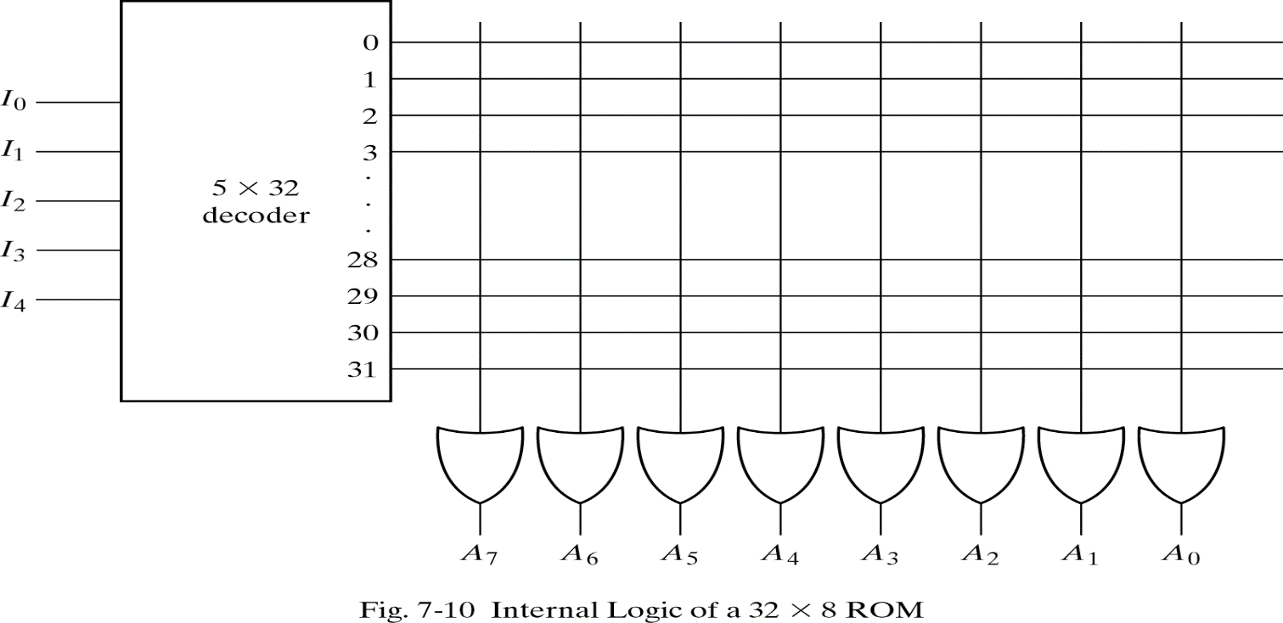
Construction of ROM
Each output of the decoder represents a memory address.
Each OR gate must be considered as having 32 inputs.
A 2^{k} X n ROM will have - k X 2^{k} decoder and n OR gates.
In figure 7-10 below for 32 x 8 ROM:
n=8, 32=2⁵ , k=5 so 5 x 32 Decoder used with 8 OR gates.

Slide 22
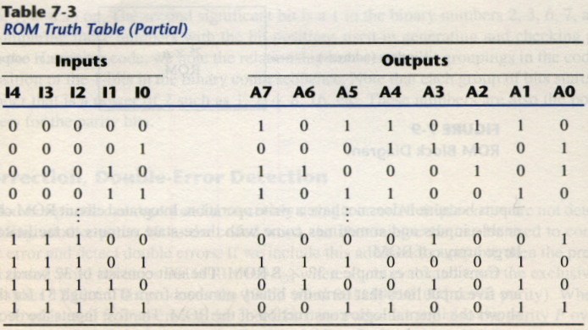
Truth table of ROM
A programmable connection between the lines is logically equivalent to a switch that can be altered to either be close or open.
Intersection between two lines is sometimes called a cross-point.

Slide 23
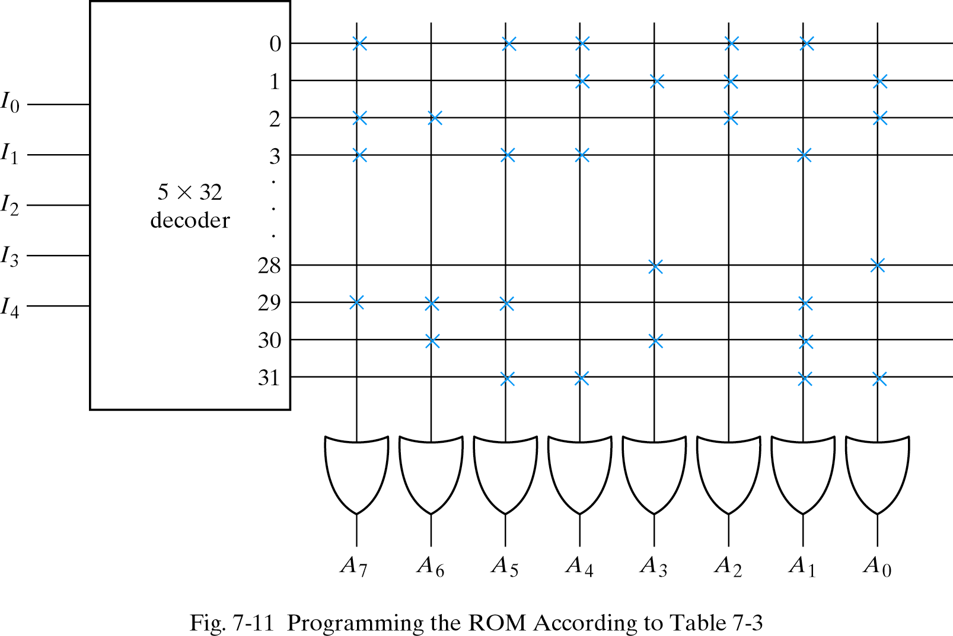
Programming the ROM
In Table 7-3, 0 → no connection
1 → connection
Address 3 = 10110010 is permanent storage using fuse link
1 0 1 1 0 0 1 0
X : means connection

Slide 24
Combinational circuit implementation
The internal operation of a ROM can be interpreted in two way: First, a memory unit that contains a fixed pattern of stored words. Second, implements a combinational circuit.
Fig. 7-11 may be considered as a combinational circuit with eight outputs, each being a function of the five input variables.
A₇(I₄, I₃, I₂, I₁, I₀) = Σ(0,2,3…,29)
Sum of minterms
In Table 7-3, output A₇

Slide 25
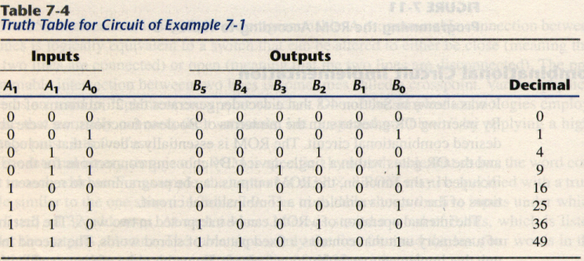
Example
Design a combinational circuit using a ROM. The circuit accepts a 3-bit number and generates an output binary number equal to the square of the input number.
Derive truth table first

Slide 26
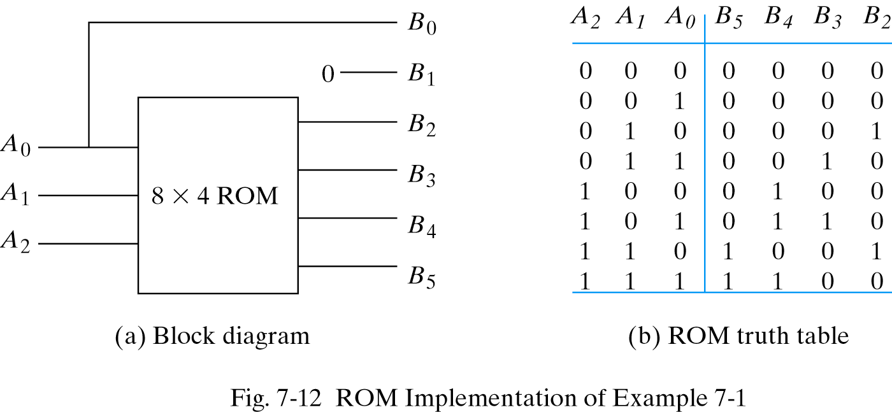
Example

Slide 27
Types of ROMs
The required paths in a ROM may be programmed in four different ways.
Mask programming: fabrication process
Read-only memory or PROM: blown fuse /fuse intact
Erasable PROM or EPROM: placed under a special ultraviolet light for a given period of time will erase the pattern in ROM.
Electrically-erasable PROM(EEPROM): erased with an electrical signal instead of ultraviolet light.

Slide 28
Combinational PLDs
A combinational PLD is an integrated circuit with programmable gates divided into an AND array and an OR array to provide an AND-OR sum of product implementation.
PROM: fixed AND array constructed as a decoder and programmable OR array.
PAL: programmable AND array and fixed OR array.
PLA: both the AND and OR arrays can be programmed.

Slide 29
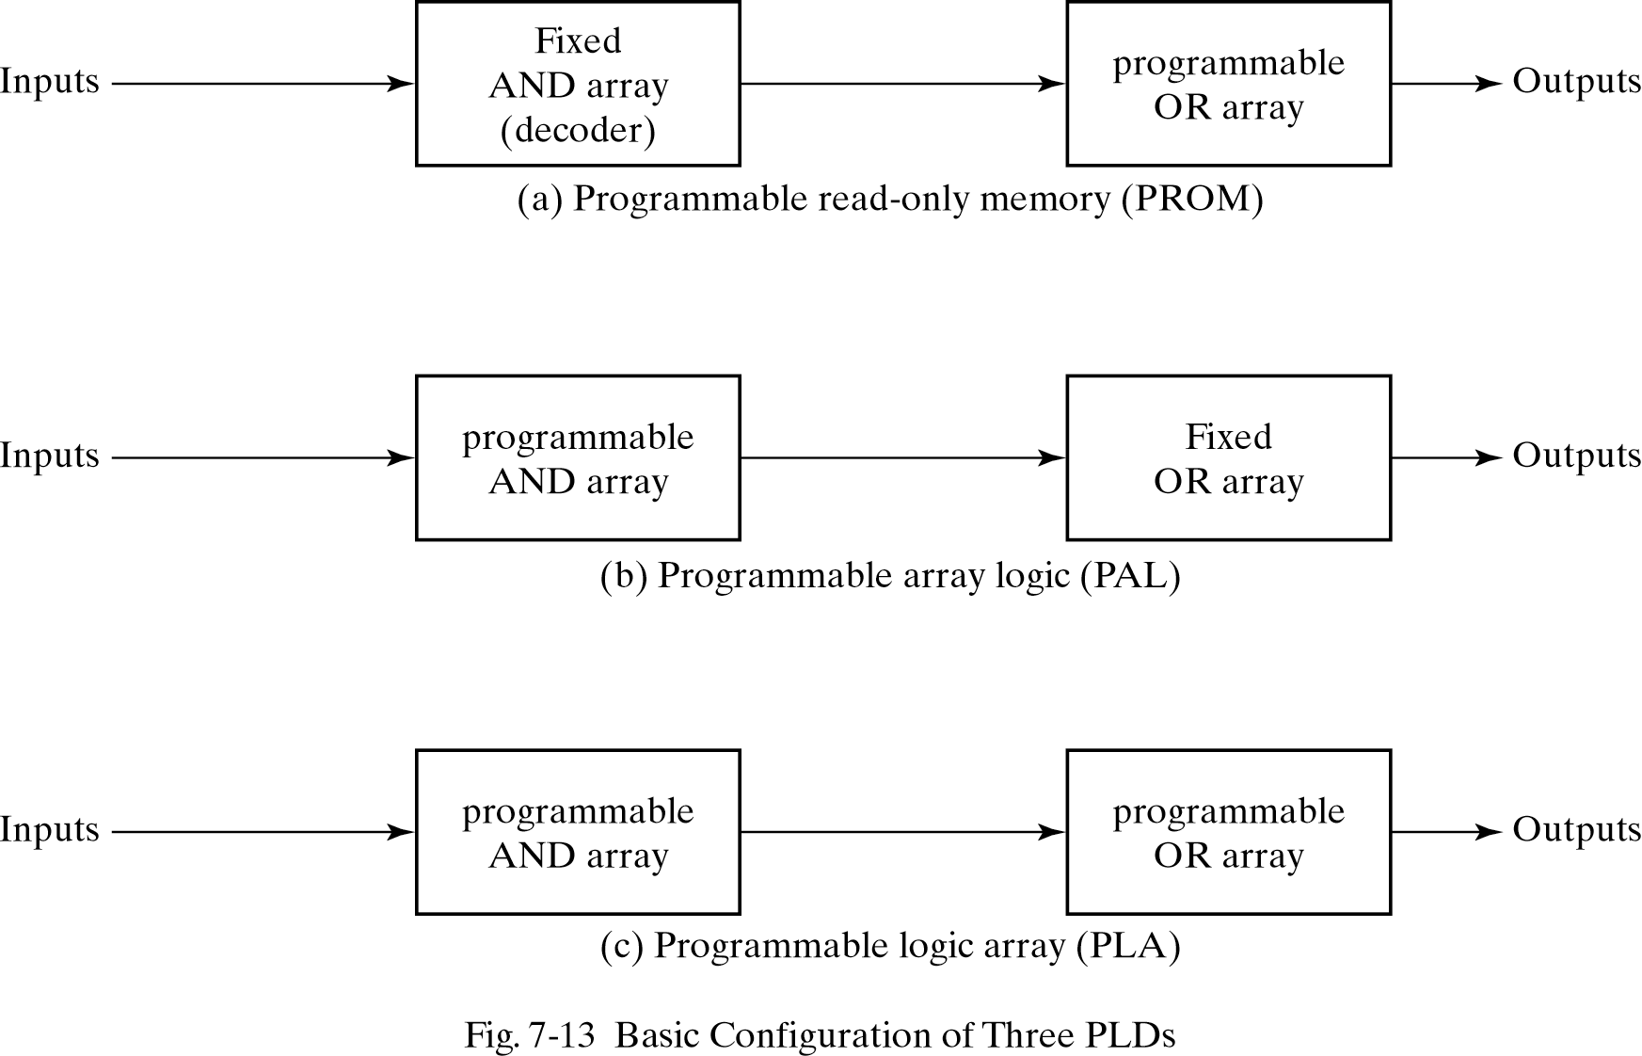
Combinational PLDs

Slide 30
4) Programmable Logic Array
In PLA the decoder from PROM is replaced by an array of AND gates that can be programmed to generate any product term of the input variables as shown in Fig.7-14.
The product terms are then connected to OR gates to provide the sum of products for the required Boolean functions.
The output is inverted when the XOR input is connected to 1 (since x⊕1 = x’). The output doesn’t change and connect to 0 (since x⊕0 = x).

Slide 31
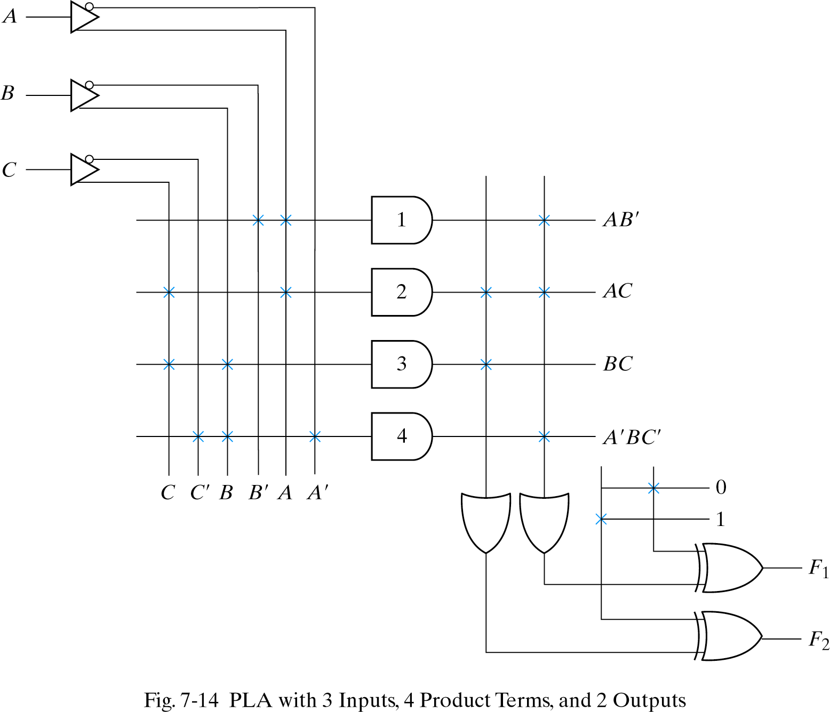
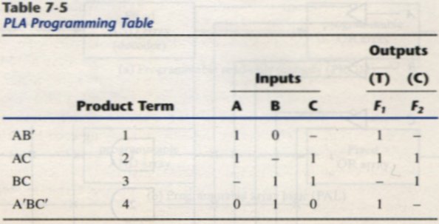
PLA
F1 = AB’+AC+A’BC’
F2 = (AC+BC)’

Slide 32
Programming Table
First: lists the product terms numerically
Second: specifies the required paths between inputs and AND gates
Third: specifies the paths between the AND and OR gates
For each output variable, we may have a T(true) or C(complement) for programming the XOR gate

Slide 33
Simplification of PLA
Careful investigation must be undertaken in order to reduce the number of distinct product terms, PLA has a finite number of AND gates.
Both the true and complement of each function should be simplified to see which one can be expressed with fewer product terms and which one provides product terms that are common to other functions.

Slide 34
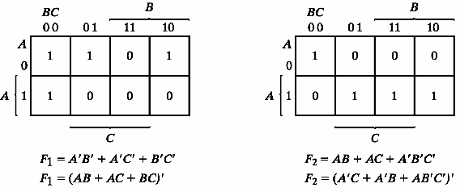
Example 7-2
Implement the following two Boolean functions with a PLA:
F₁(A, B, C) = ∑(0, 1, 2, 4)
F₂(A, B, C) = ∑(0, 5, 6, 7)
The two functions are simplified in the maps of Fig.7-15
1 elements
0 elements

Slide 35
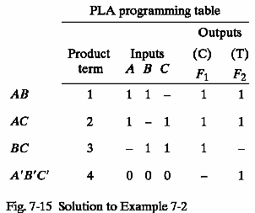
PLA table by simplifying the function
Both the true and complement of the functions are simplified in sum of products.
We can find the same terms from the group terms of the functions of F₁, F₁’,F₂ and F₂’ which will make the minimum terms.
F1 = (AB + AC + BC)’
F2 = AB + AC + A’B’C’

Slide 36
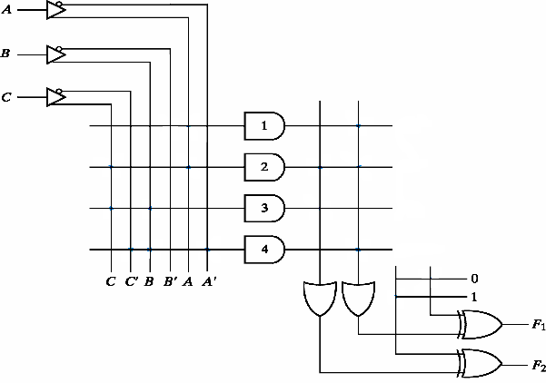
PLA implementation
AB
AC
BC
A’B’C’

Slide 37
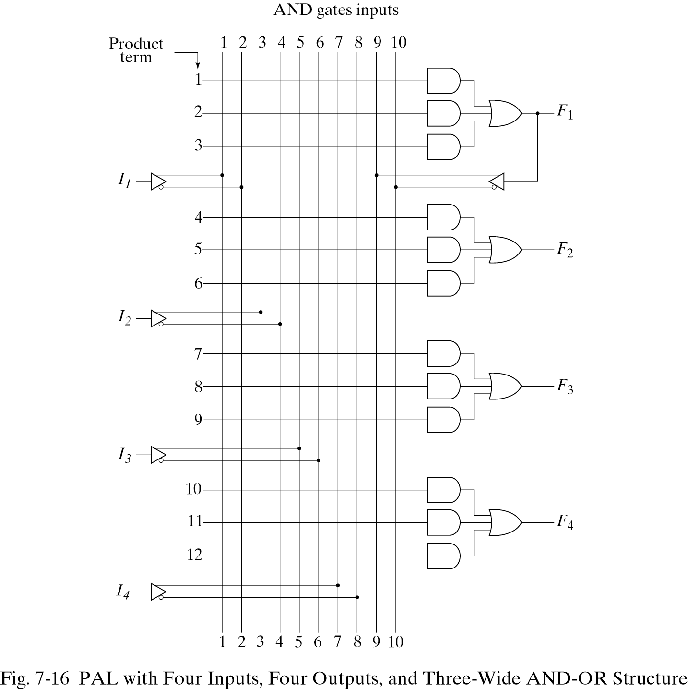
5) Programmable Array Logic
The PAL is a programmable logic device with a fixed OR array and a programmable AND array.

Slide 38
PAL
When designing with a PAL, the Boolean functions must be simplified to fit into each section.
Unlike the PLA, a product term cannot be shared among two or more OR gates. Therefore, each function can be simplified by itself without regard to common product terms.
The output terminals are sometimes driven by three-state buffers or inverters.

Slide 39
Example
w(A, B, C, D) = ∑(2, 12, 13)
x(A, B, C, D) = ∑(7, 8, 9, 10, 11, 12, 13, 14, 15)
y(A, B, C, D) = ∑(0, 2, 3, 4, 5, 6, 7, 8, 10, 11, 15)
z(A, B, C, D) = ∑(1, 2, 8, 12, 13)
Simplifying the four functions as following Boolean functions:
w = ABC’ + A’B’CD’
x = A + BCD
y = A’B + CD + B’D’
z = ABC’ + A’B’CD’ + AC’D’ + A’B’C’D = w + AC’D’ + A’B’C’D

Slide 40
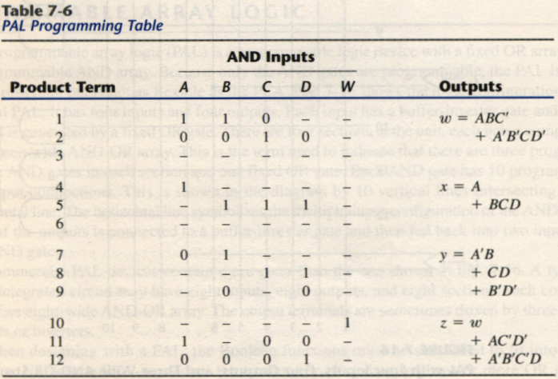
PAL Table
z has four product terms, and we can replace by w with two product terms, this will reduce the number of terms for z from four to three.

Slide 41
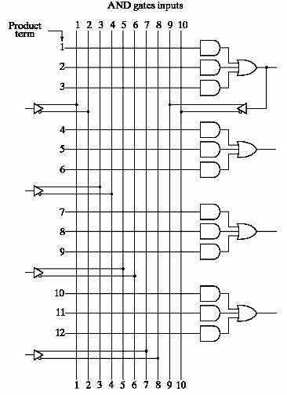
PAL implementation
w
A
x
B
y
C
z
D

Slide 42
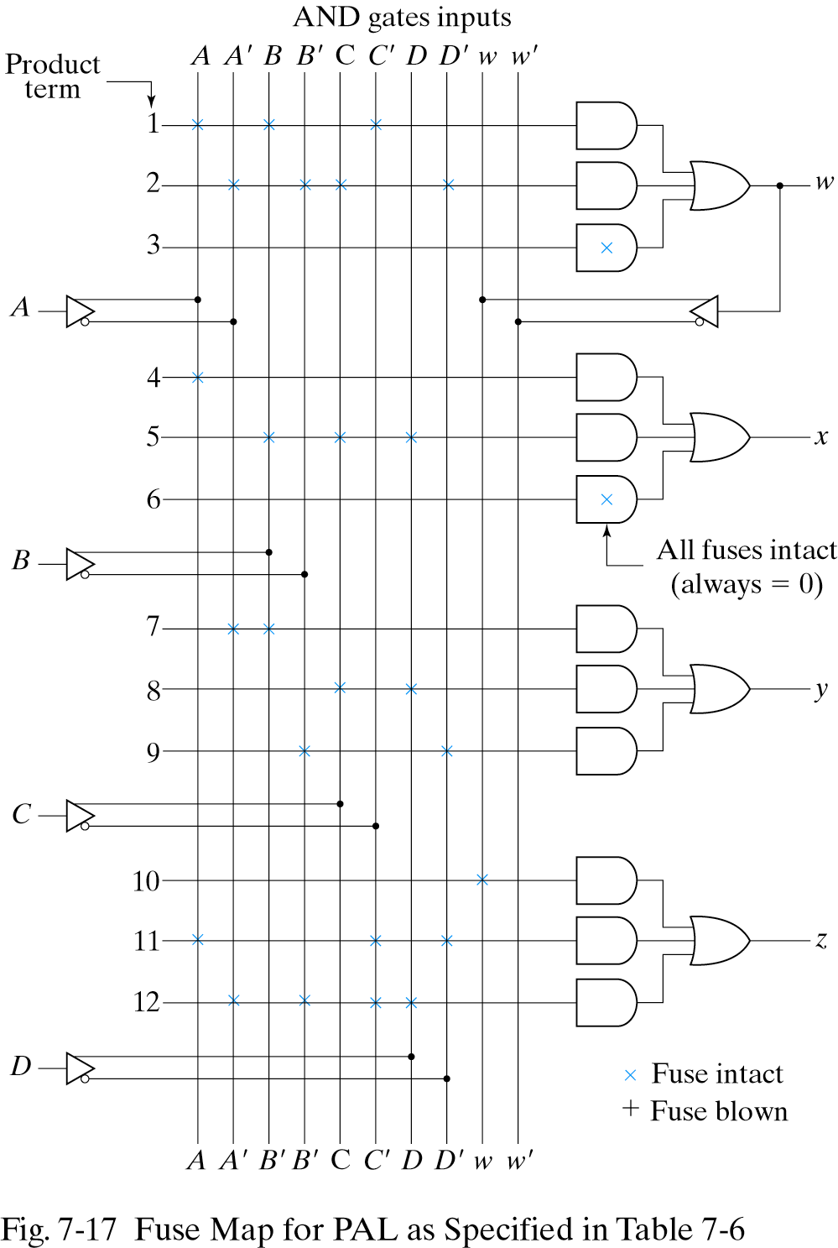
Fuse map for example

